Slide 1


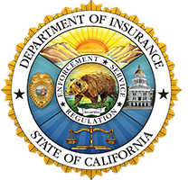
Homeowners Insurance
Presentation
Sharon Smith
Outreach Analyst
California Department of Insurance

Slide 2

Insurance at a Crossroads in California
Growing climate change threats
Historic inflation
Several insurers stopped writing and non-renewing policyholders despite approval of multiple rate increases
Accelerated FAIR Plan growth
Fewer options and higher costs
Outdated decades-old regulations
Sustainable Insurance Strategy
Notes:
Before we dive into what the Department is doing, it’s important to first understand how we got here in the insurance marketplace. Insurance companies are leaving the state, more policyholders are turning to the FAIR Plan, policy cancellations are on the rise, but these actions are not arbitrary. They reflect the financial and risk-based challenges that insurers are facing.
None of this happened overnight, several key factors are driving these changes. The increasing severity and frequency of natural disasters as well as rising global inflation is putting stress on the insurance industry nationwide, not just in California. The cost of rebuilding homes and businesses has surged, with rising prices for materials, labor shortages, and supply chain disruptions.
Reinsurance—insurance for insurance companies—is becoming harder to obtain and more expensive, as catastrophic events increase worldwide.
As risks grow, the insurance market is contracting to protect financial stability. Unlike public utilities, insurance companies are not legally required to offer coverage unless they can fully meet all claims, cover their expenses, and earn a fair return.
But, the primary regulatory framework for insurance in California, Proposition 103, was passed in 1988. Since then, the landscape has changed dramatically, but the regulatory system has not kept pace. Recognizing this, Commissioner Lara has taken steps to modernize these outdated regulations to create a more resilient insurance market.

Slide 3

Governor’s Executive Order N-13-23
To Strengthen Property Insurance Market
Insurance Commissioner’s
Sustainable Insurance
Strategy
(Announced September 2023)
Streamline and improve Department’s rate application approval process
Introduce new risk management tools in ratemaking – Catastrophe Modeling and Reinsurance Costs
Insurer commitments to write more policies in wildfire distressed areas and reduce FAIR Plan policies
Strengthen and Modernize FAIR Plan
Sustainable Insurance Strategy
Notes:
Which brings us to the Sustainable Insurance Strategy (SIS). Due to the pressing challenges facing the insurance market, Commissioner Lara, with the support of the Governor’s executive order, announced SIS in September 2023. This initiative introduces a series of regulatory reforms aimed at increasing the availability of insurance for Californians, creating a more resilient insurance market, and protecting communities from the growing risks of climate change.
The key initiatives under the strategy include:
First, streamlining and improving the Department’s rate application approval process to reduce delays and ensure that insurers can adjust to changing market conditions more efficiently.
Second, introducing new risk management tools in ratemaking, such as catastrophe modeling and the incorporation of reinsurance costs. These tools will allow insurers to assess risk more accurately and account for wildfire mitigation efforts.
Finally, increasing the availability of insurance in wildfire-distressed areas. By requiring insurers to write more policies in high-risk zones, the Department aims to reverse the growing reliance on the FAIR Plan and close the insurance gap, ensuring that more Californians have access to traditional insurance options.
If any of this seems unclear, don't worry—I’ll be diving into each of these actions in more detail and you’ll have time to ask questions at the end as well.

Slide 4

What’s Next for SIS?
Catastrophe models reviews are complete.
Insurance companies will need to submit complete rate applications
Insurance Companies expected to have new policies available once applications are approved
Sustainable Insurance Strategy
Notes:
Catastrophe models are now being submitted for review – Verisk and Moody’s are being reviewed now with more expected in months.
Insurance companies will need to submit complete rate applications to use these catastrophe models and incorporate reinsurance.
Insurance companies expected to have new policies available mid-2025.

Slide 5

Disaster Preparedness
Follow all evacuation orders from local authorities.
If time allows, locate your insurance policy documents and upload them to the cloud using your mobile device.
If time allows, make a photo or video inventory of your possessions. An inventory can be completed quickly and easily on your smart phone and safely stored in the Cloud.
Notes:
Switching gears from what the Department is doing to what you can do to prepare for disasters pertaining to insurance.
In the event of an emergency, always follow evacuation orders from local authorities to keep yourself and your family safe. That’s first and foremost. If time allows, locate your insurance policy documents and upload them to a secure cloud storage service using your smart phone. Send them to your email. Have it somewhere that’s easily accessible in the event that you unfortunately need to use it.
Another crucial step is creating a photo or video inventory of your possessions. To process a contents claim, insurers need to know what items you owned—this includes clothing, furniture, electronics, kitchenware, and other valuables. I know documenting everything you own may seem overwhelming, but trust me you don’t want to do this after a loss. Take a video of your home, open the cupboards and cabinets, and make sure you update it yearly. There’s also a home inventory app from the National Association of Insurance Commissioners (NAIC). Look up the NAIC Home Inventory app. It will take you room by room to document and also gives you the ability to scan barcodes and upload photos so everything is in one place.

Slide 6
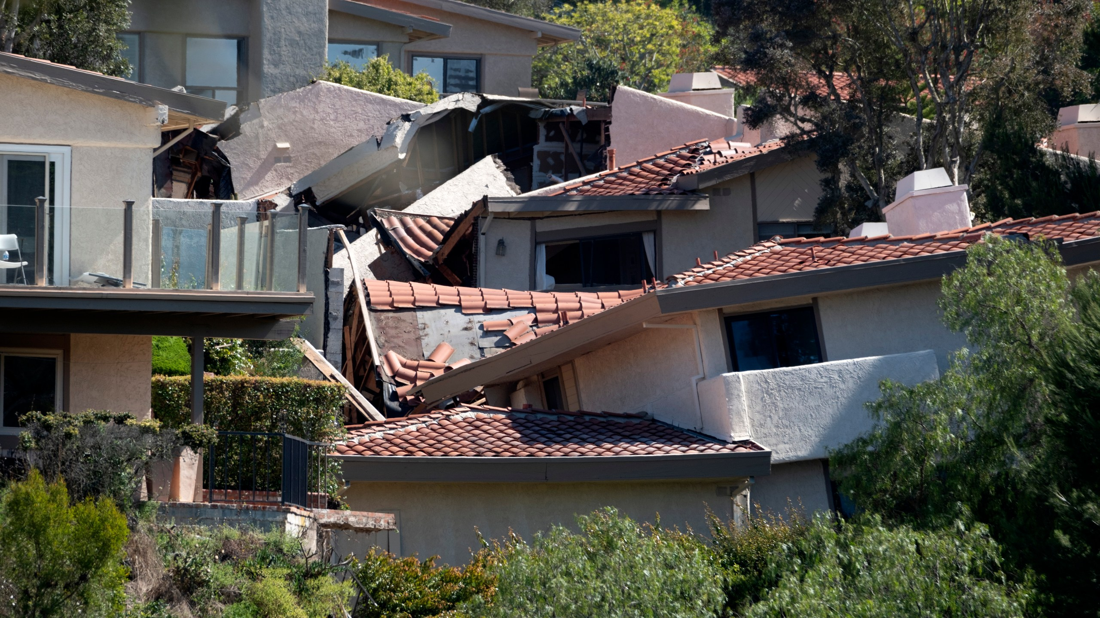
Do You Have Enough Coverage?
Up to 8 in 10 homeowners and renters are underinsured for their home and contents.
Rebuilding cost is NOT home’s selling price
Actual Cash Value versus Replacement Cost
Building code upgrades
Construction costs SOAR after a disaster
Ask for your wildfire risk score
Notes:
The other crucial part of disaster preparedness as it pertains to insurance is making sure you have enough coverage. The worst time to find out you are underinsured is after a catastrophe.
Reports indicate that up to 8 out of 10 homeowners are underinsured. Simply put, if you have a total loss, you won’t have enough money to rebuild your home. Just imagine, you’ve been paying your premiums every year for 20 years without a question and to find out that you don’t have enough to rebuild. First part is knowing if you have enough coverage?
Other part is knowing do I have the right coverage? Being in Southern California most of us are concerned with wildfires and earthquakes, but the torrential rains this time last year brought catastrophic flooding to areas in Los Angeles County and San Diego county and highlighted the vast majority of victims did not have flood insurance…And in general less than 2% of California homeowners have flood coverage. I don’t sell insurance. I’m not telling you to go out and get flood coverage today, it is really going to depend on a lot of independent factors about where your home is located and such but these are the not so fun parts of homeownership that you don’t know about until it’s too late.
Now let’s look at some of the many reasons why you could be underinsured.
One thing I really need you all to take away from this webinar today is that rebuilding cost is NOT the home’s selling price.
If a disaster were to happen and you have to rebuild your home you have to think about the new regulations and building codes that have been put in place since your home has been built. For example, interior sprinklers are now required in new builds. Those upgrades can easily add 35 to 50 percent to the cost. Permits themselves have tripled in cost in some cities. Also following a disaster where large areas are affected, construction costs sky rocket due to lack of construction crews, materials, inspectors, etc.
You need to know if your policy is a replacement cost value policy or an actual cash value policy. If it’s a cash value policy, it will not cover a rebuild. If you have a replacement cost value policy, it may. Some types of replacement cost policies will pay your policy limits, plus a certain percentage above those limits. But don’t just think because you have a replacement cost policy you’re good, you’ll never have to think of it again. No. Review your replacement cost value policy every year when you renew. It might have cost 600k to rebuild your home when you first bought it and 3 times as much now.
Ask yourself, do I have enough coverage to rebuild? If you don’t know the answer then talk with your agent.
Ask your agent –If your agent can’t give you the answer, then maybe it’s time to find another agent. Many agents will reduce your premium to make their rates competitive. Reducing premiums saves you money in the short-term, but cost you a lot in the long term. A home is a huge investment, you want to make sure you have enough coverage to protect that investment.
Another thing I would like to discuss is most people do not know that insurance companies assign a risk score to your home or business. People are hungry for this information – because if you know about the risks on your property, you can act to reduce them and make yourself and your neighbors safer.
The Safer from Wildfires Regulation passed by the Commissioner in 2019 requires insurance companies to give you the wildfire risk score for your property. They have to tell you how they created that score and what factors went into the score.
The wildfire risk score or classification must be provided to you at the following times:
-When you apply for a new policy (within 15 days)
-Before you renew a policy (at least 45 days)
-Before you are non-renewed (at least 75 days)
-When you complete mitigation on your property and request a revised score (within 30 days)
You also have the right to appeal your score. And if you are not satisfied with the response, the Department of Insurance can help you with this process.

Slide 7


Tips for Finding Insurance
If you get a nonrenewal notice, contact your insurer and ask if there are any specific actions you could take to mitigate your risk and retain your coverage.
In California your insurer must give a minimum of 75-days notice before your policy expires.
If you think your nonrenewal was unfair, you may file a complaint with the California Department of Insurance.
You may try obtaining coverage in the “surplus lines” market. (Note, surplus lines insurers are not backed by the California Insurance Guarantee Association.)
7
Notes:
So, what are some steps you can take if you can’t find insurance. Which is the case for many Californians.
If you get a nonrenewal notice, contact your insurer and ask if there are any specific actions you could take to mitigate your risk and retain your coverage. Ask for your risk score if it wasn’t already provided.
In California your insurer must give a minimum of 75-days’ notice before your policy expires. If you think your nonrenewal was unfair, you may file a complaint with us. Many times, we’re able to get the non-renewal reversed if the insurance company didn’t give you enough notice.
You may try obtaining coverage in the “surplus lines” market. Surplus lines are your non-admitted insurers.
Surplus lines insurers are not backed by the California Insurance Guarantee Association so there aren’t as many protections for your claims under our Department because they’re not licensed by our state. They may be based in another state or internationally. Doesn’t mean they shouldn’t be considered, but it is worthwhile to note.
More tips on our website top 10 tips for finding insurance. Call us during business hours if you have any further questions.

Slide 8
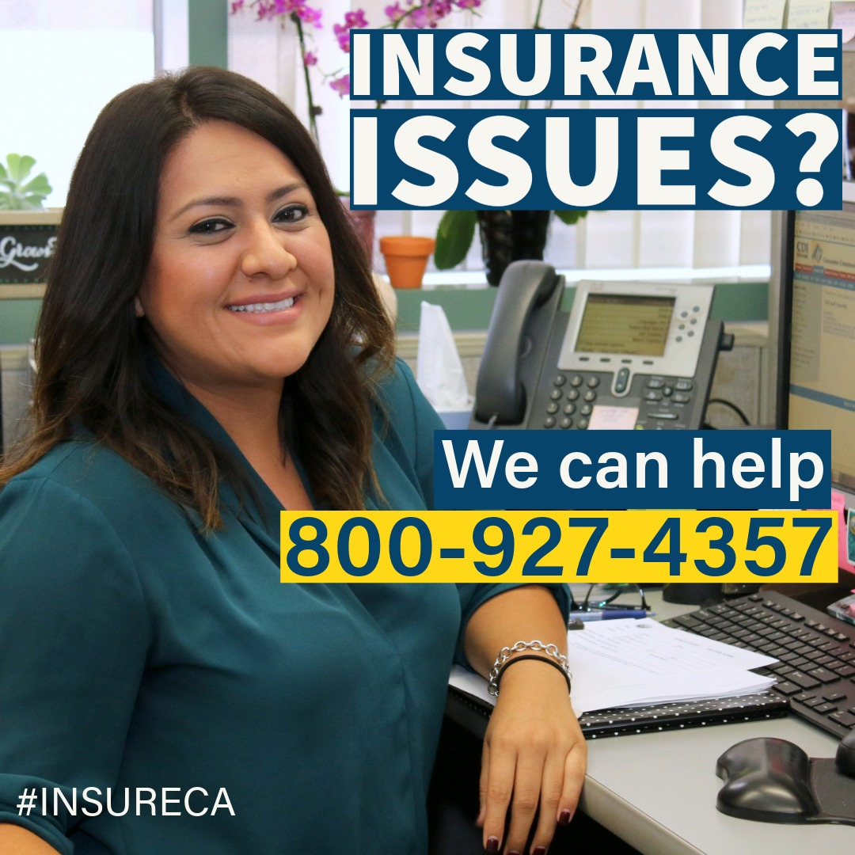
Notes:
We will now open the floor for general questions. For questions about your specific policy, please call our hotline at (800) 927-4357 for detailed assistance.

